Slide 1


2D Object Detection and Tracking
With
Autonomous Driving Data
Anik Sarker | PhD Mechanical Engineering, Robotics, 3D Vision.
Mautushi Das | PhD Animal Science, Computer Vision, Animal Behavior Prediction.

Slide 2
Motivation
Traffic Monitoring (Violation)
Autonomous Driving Algorithms
Notes:
The Problem of object detection is fairly straightforward. We want the AI to detect the object. However, 2d object detection and tracking has numerous applications in remote traffic monitoring and autonomous driving.

Slide 3
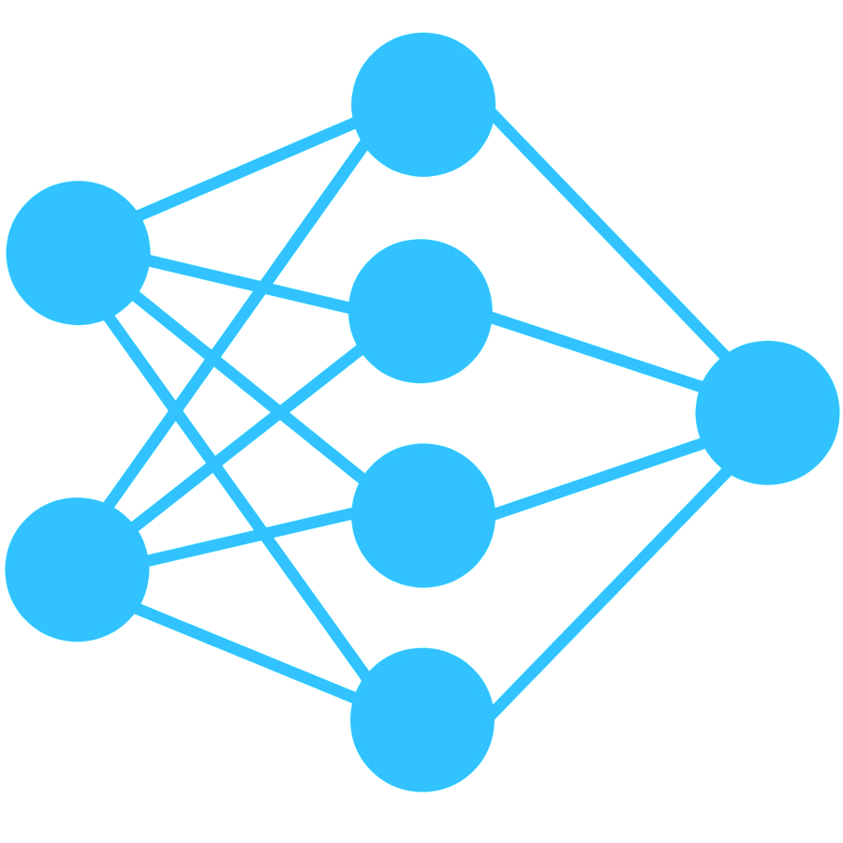
Our Approach
Dataset
(SODA 10 M)
Largest 2D dataset for Autonomous Driving
6 Object Class
Train Set
Val Set
Input Test Video/Image
Backbone YOLO NAS Model
(Pretrained With COCO Dataset)
State-of-the-art YOLO Model
Fine Tuned YOLO NAS
Fine Tune
Frame Wise Prediction
DEEP SORT Model (for Tracking)
Prediction YAML
Frame Wise Tracking
Combine Tracking Frames = Output Video

Slide 4
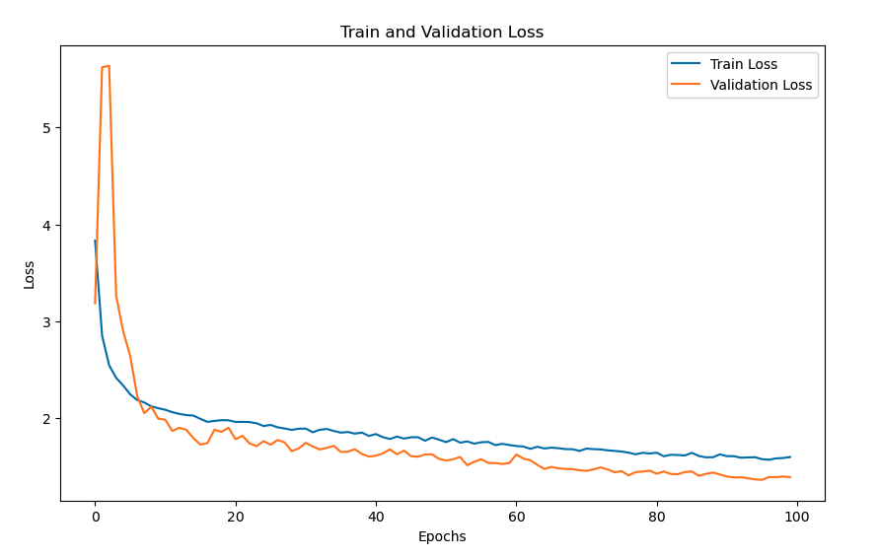
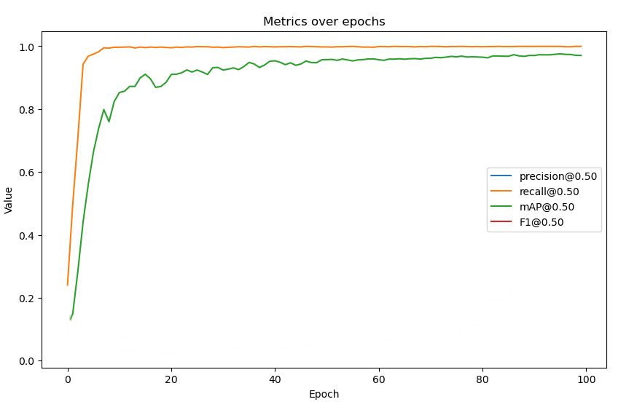
Training Result (Detection)
Test Result
(Detection)
Train Loss
mAP@0.50
Validation Loss
Recall@0.50

Slide 5
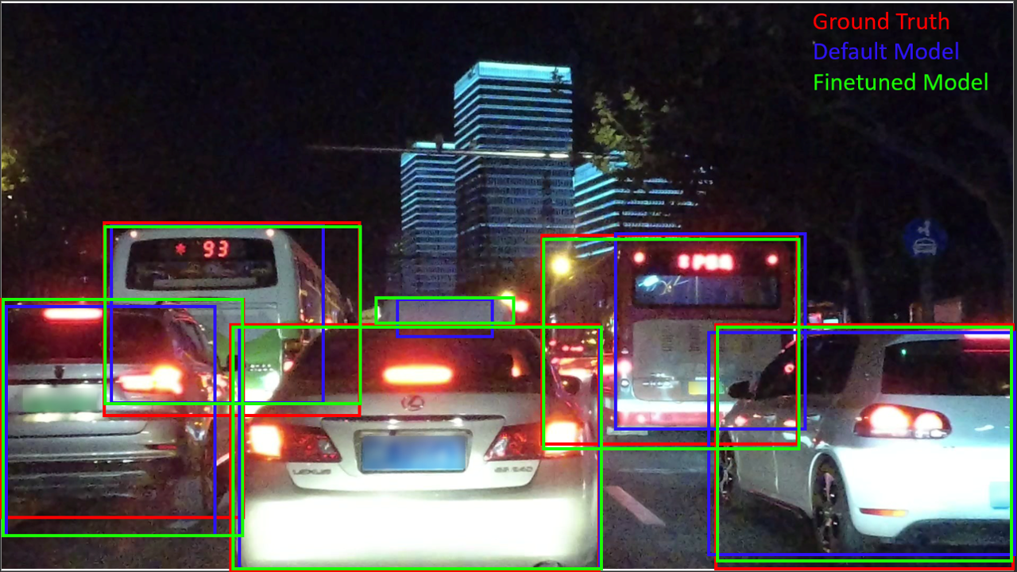
Visual Result (Detection)
mAP@0.50
Default YOLO NAS | Finetuned YOLO NAS
0.735 | 0.973

Slide 6
Results (Detection and Tracking)
Summary:
Finetuned state-of-the-art YOLO NAS model for 2D object detection with the largest autonomous vehicle detection dataset.
Tracking was performed using DEEP SORT.
Work Remaining: Organizing codes, Report Writing
We will make our codes public after the project.

